Slide 1
2015 Flight Delays and Cancellations
Lee Waters
12/01/2022

Slide 2
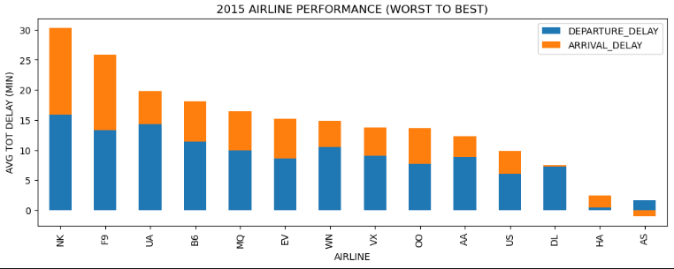
NK performed the worst, whereas AS performed the best. UA ranked 3rd from worst with delays primarily from departures.
Notes:
y-axis min/flight

Slide 3
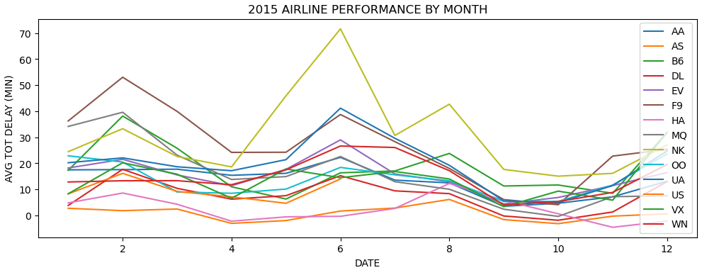
Airline performance fluctuates with apparent seasonal variation throughout the year. The best performers are typically smaller airlines (US, HA), whereas the worst performers alternate.
Notes:
y-axis min/flight

Slide 4
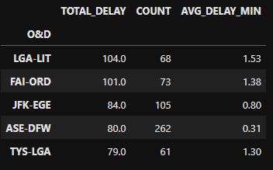
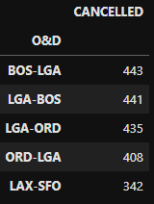
Top delays between large/small airports. Top cancelled from LGA, BOS, and ORD (all large cold weather airports). LGA also suffers major delays.
Top 5 Delayed O&D (Min 50 Flights)
Top 5 Cancelled O&D
Notes:
Fairbanks (FAI)
Aspen (DFW)
Tyson/Knocksville (TYS)

Slide 5
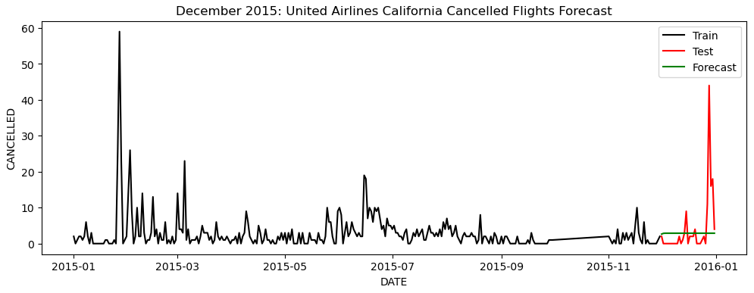
Cancelled flights forecast below actual by 2.1 M.A.E. Large cancellations in December that may be difficult to forecast using conventional time series methods.
Notes:
Machine learning approach
DATE
DAY_OF_WEEK
AIRLINE
O&D
SCHEDULED_DEPARTURE
SCHEDULED_ARRIVAL
DISTANCE
Other delays (e.g. AIR_SYSTEM_DELAY, SECURITY_DELAY, AIRLINE_DELAY, LATE_AIRCRAFT_DELAY, WEATHER_DELAY)
Be careful of target leakage

Slide 6
Recommendations
Investigate best practices of other top performing legacy carriers (e.g. DL)
Concentrate efforts on reducing departure delays
Anticipate peak demand periods that may be exacerbating delays and pre-emptively adjust inventory/scheduling
Investigate troublesome routes/airports and troubleshoot possible bottlenecks
Improve forecasting model to better anticipate cancellations and act proactively

Slide 7
Questions?

